Slide 1
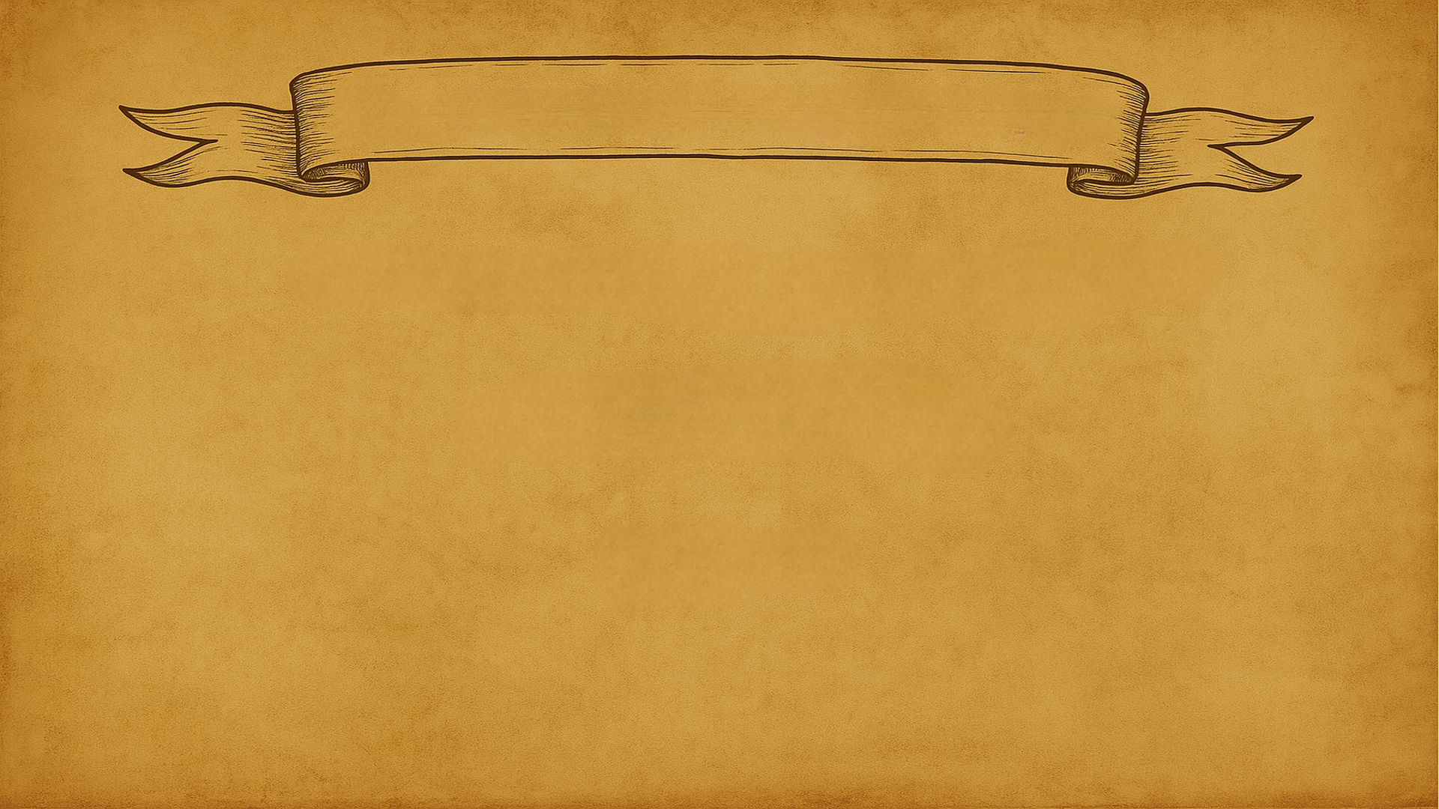
PRINCIPLES of DATA ANALYSIS
Summer 2025 Workshop Series
Ali Tafakkor
July 10

Slide 2
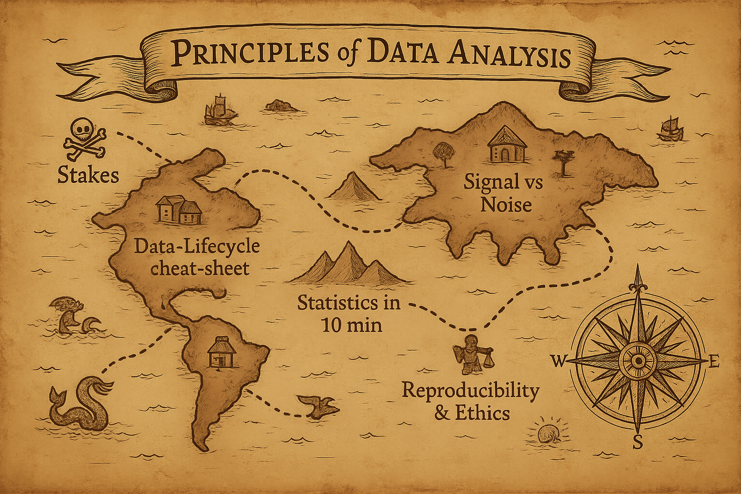

Notes:
Here’s our flight‑plan. Each block has a micro‑demo so you see the concepts in action.

Slide 3
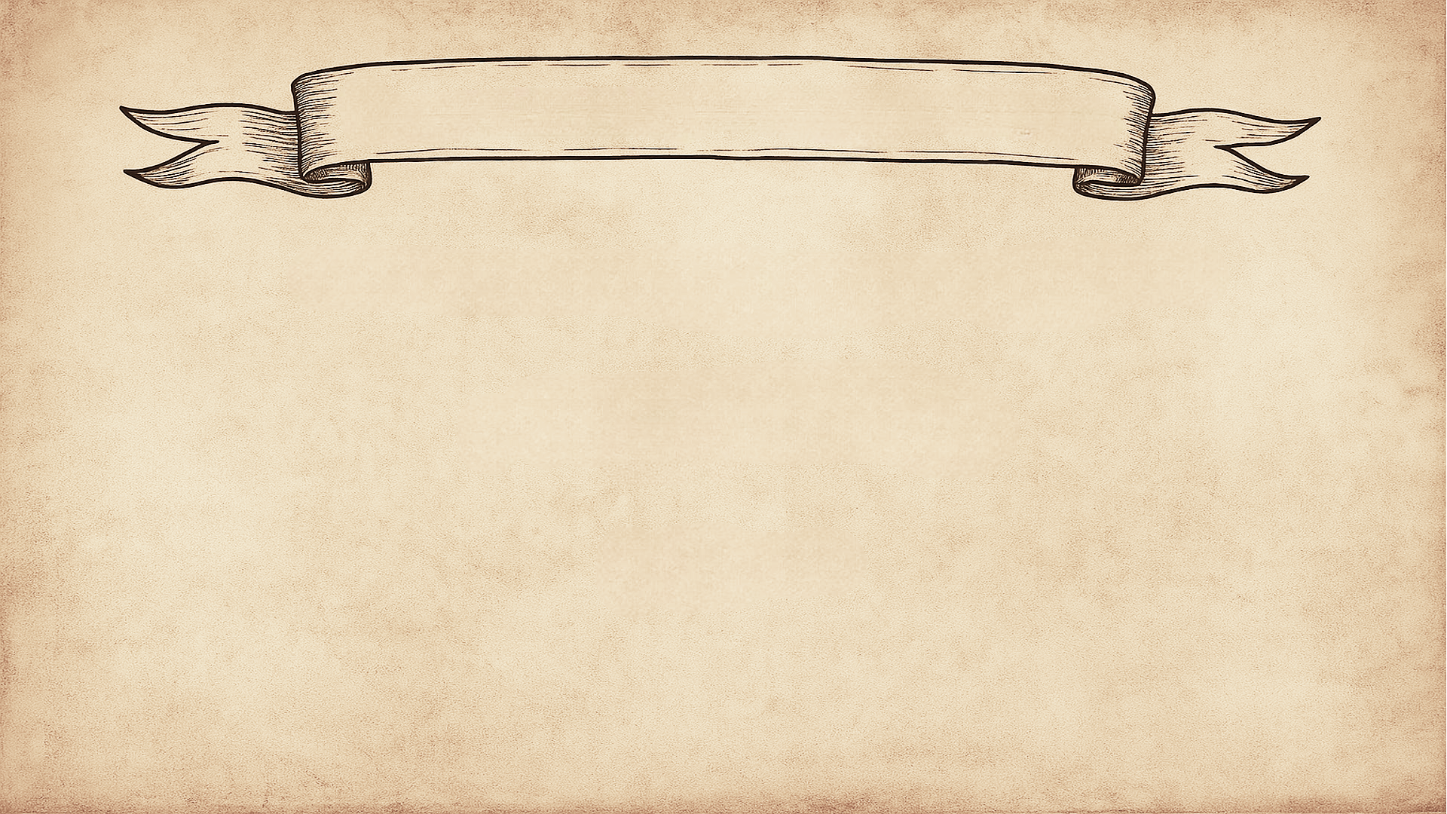
DON’T be THAT RESEARCHER
Retractions & wasted effort
Ethical responsibility to participants
Trust of the public & scientific community
Your future CV & credibility
Notes:
Why is this discussion important?
The 2012 “voodoo correlations” fMRI story: “Back in 2012, there was a big controversy in fMRI research called the ‘voodoo correlations’ scandal. People realized that some studies were reporting brain–behavior correlations that were way too high — because they were using the same data twice: first to find the strongest voxels, and then again to report the correlation. That kind of circular analysis inflated the results and led to a major push for more careful and transparent methods.”

Slide 4
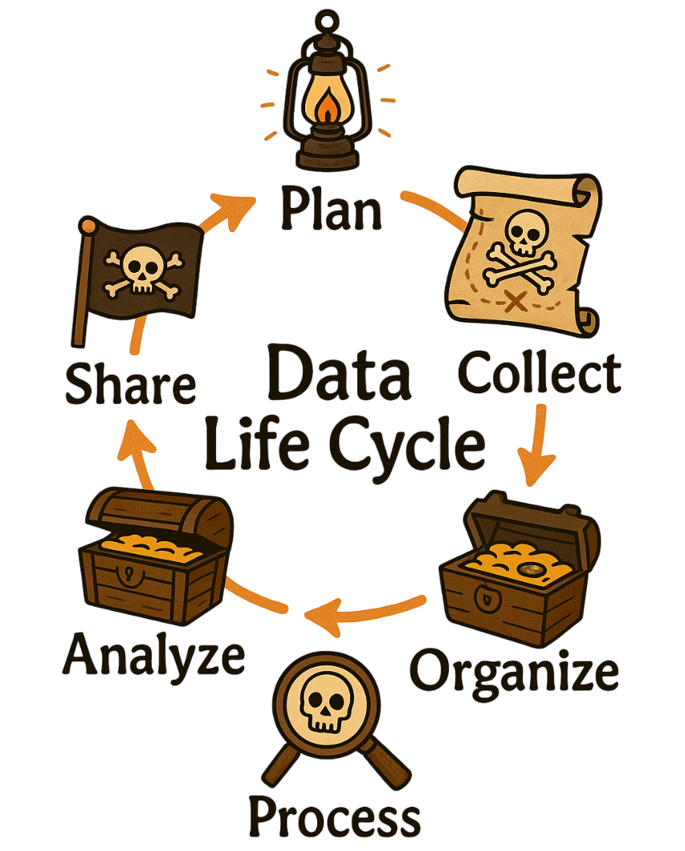
THE 6-STAGE DATA LIFECYCLE

Slide 5
THE 6-STAGE DATA LIFECYCLE
Stage | One‑line best practice | Tool | Pitfall
Plan | Write hypotheses before data | OSF prereg | HARKing
Collect | Log everything | Scanner/EEG triggers | Missing keys
Organize | Name & version your files | BIDS + Git | "final_final.xlsx"
Process | Keep raw immutable | MNE, fMRIPrep | Over‑write raw
Analyze | Match stats ↔ question | GLM, cross‑val | p‑hacking
Share | FAIR & anonymize | Zenodo, OpenNeuro | Private data leaks
Notes:
~1 min on each stage.
Shout a pitfall you see.
FAIR: Findable, Accessible, Interoperable, and Reusable

Slide 6
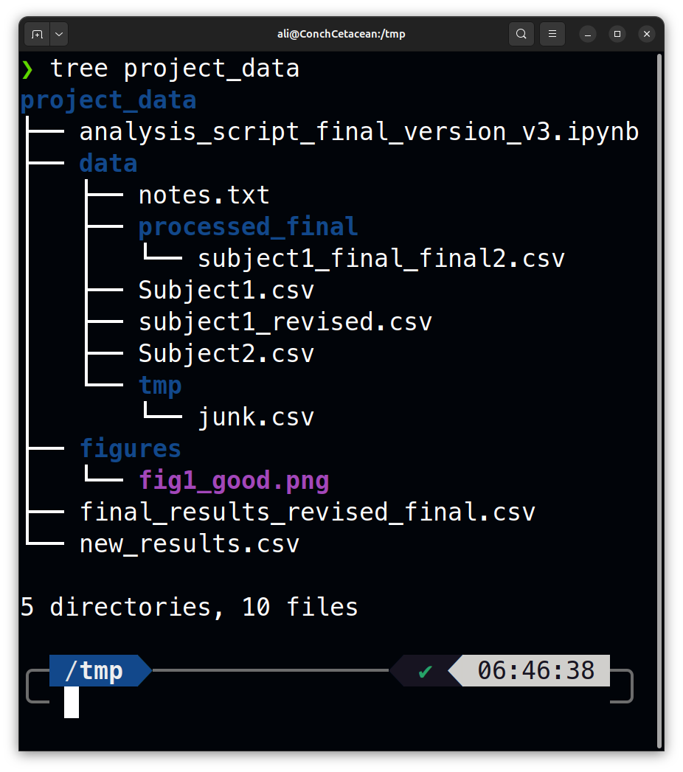
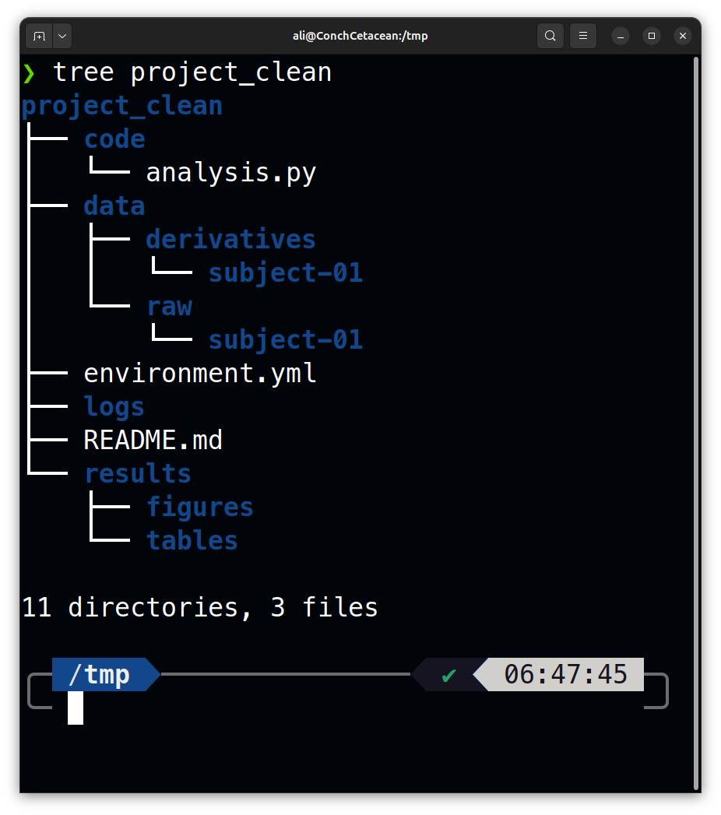
THE 6-STAGE DATA LIFECYCLE
Notes:
15 s lightning round—what’s wrong with this structure?” Record 2‑3 answers, tie back to Stage 3.

Slide 7

SIGNAL vs NOISE
What is signal? Meaningful variation linked to experimental variables
What is noise? Random or systematic variation unrelated to the hypothesis
What is a covariate? A source of variation that is not the main variable of interest but must be modeled (e.g., motion, age)
Why denoise? To improve sensitivity, reduce bias, and avoid spurious results
How do we denoise? Filtering, ICA, regression, motion censoring, global signal regression, etc.
Importance of preprocessing & QC: garbage in, garbage out!
What is signal?
What is noise?
What is a covariate?
Google Colab
Why denoise?
How do we denoise?
Importance of preprocessing & quality assurance (QA): garbage in, garbage out!
Notes:
What is signal? Meaningful variation linked to experimental variables
What is noise? Random or systematic variation unrelated to the hypothesis
What is a covariate? A source of variation that is not the main variable of interest but must be modeled (e.g., motion, age)
Why denoise? To improve sensitivity, reduce bias, and avoid spurious results
How do we denoise? Highly depends on the data, Filtering, ICA, regression, motion censoring, global signal regression, etc.
Importance of preprocessing & QC: garbage in, garbage out!
All neural data is a mix of signal, noise, and structured confounds. Example: In EEG, the ERP is the signal, eye blinks are noise, and subject fatigue could be a covariate.
"Good preprocessing is invisible—bad preprocessing ruins your results." QC starts visually.

Slide 8
REPRODUCIBILITY & ETHICS
Things to do starting today
Back up your work (GitHub, cloud, rsync)
Add a README to every project
Log your preprocessing steps
Use version control (e.g., Git)
Lock raw data as read-only
Anonymize and get consent
Respect licenses and cite reused data
…
The list goes on, choose a few that are most relevant for your work at this stage and start.
Notes:
Good practices aren't just for sharing—they protect you and your work.“Imagine explaining your analysis to your future self or PI in 6 months. Leave breadcrumbs.

Slide 9
STATISTICS in 10'
What is a p-value?
It’s not the chance your hypothesis is correct
Google Colab
Beware multiple comparisons
Notes:
A p-value is the probability of getting data as extreme as yours if the null hypothesis were true

Slide 10


